Slide 1
Event-Driven Stock Prediction
By:
Xu Gao,
Scott Edenbaum

Slide 2
Table Of Contents
Overview
Research
Reference Paper
Project topic
Data
Web scraping
Data Cleaning
Database storage
Model development
Prediction and trading results
Conclusions and insights
Q & A

Slide 3
Preliminary Research
Reference Papers
Deep Learning for Event-Driven Stock Prediction
Xiao Ding, Yue Zhang, Ting Liu, Junwen Duan
Built a neural tensor network to transform word embeddings to event embeddings to be used as the input for stock prediction neural network
Deep Learning in Finance
J. B. Heaton , N. G. Polson, J. H. Witte
Introduced deep learning techniques used in finance
Eg: Shallow Factor Models, Default Probabilities, Event Studies

Slide 4
Project Topic
Event-driven stock prediction
What is it?
How can we use it?
Project Motivation
Background in finance
Interest in financial modeling
Lack of research
NLP analysis

Slide 5
Data Sources
Data Sources
News events
Seeking Alpha
Selenium
BeautifulSoup
Pricing data
Bloomberg terminal

Slide 6
Data hurdles
Finding news source
Content relevance
Content consistency
Historical data
Bot & web scraping detection
Inconsistent structure of news content
Seemingly random XPath values

Slide 7
Data Scraping
Selenium
BeautifulSoup

Slide 8
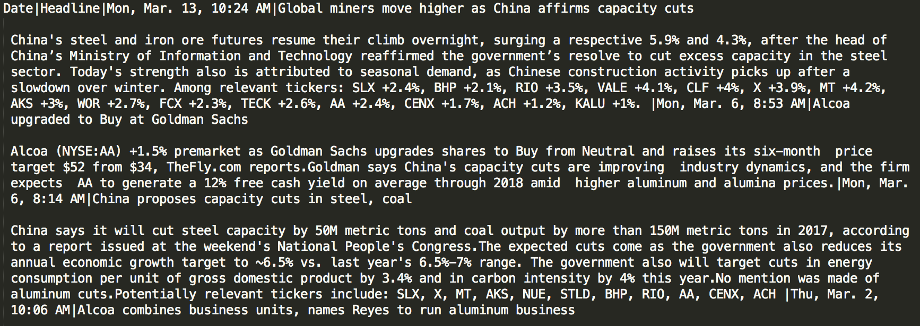
Data Cleaning
Extract from data
Headline
Content
Date & time

Slide 9
Data Pre-Processing
ReVerb
Java tool for text processing
identifies ”similar” words
Identifies & extracts binary relationships in English sentences
Designed for use with “Web-scale” information extraction
Eg: ”is” -> “be”, “was” -> “be”
Conceptually similar to nltk “stemming”
Each news item/event is a separate input for ReVerb

Slide 10
ReVerb Results
ReVerb Sample Output
1 China ‘s steel and iron ore futures resumetheir climb 0 7 7 8 8 10 0.8225299076805256 China 's steel and iron ore futures resume their climb overnight , surging a respective 5.9 % and 4.3 % , after the head of China’s Ministry of Information and Technology reaffirmed the government’s resolve to cut excess capacity in the steel sector . NNP POS NN CC NN NN NNS VBP PRP$ NN RB , VBG DT JJ CD NN CC CD NN , IN DT NN IN NNP NNP NNP IN NNP CC NNP VBD DT NN VBD NN TO VB JJ NN IN DT NN NN . B-NP I-NP I-NP I-NP I-NP I-NP I-NP B-VP B-NP I-NP B-ADVP O B-VP B-NP I-NP I-NP I-NP O B-NP I-NP O B-PP B-NP I-NP I-NP I-NP I-NP I-NP I-NP I-NP I-NP I-NP B-VP B-NP I-NP B-VP B-NP B-VP I-VP B-NP I-NP B-PP B-NP I-NP I-NP O china 's steel and iron ore futures resume their
Not human readable

Slide 11
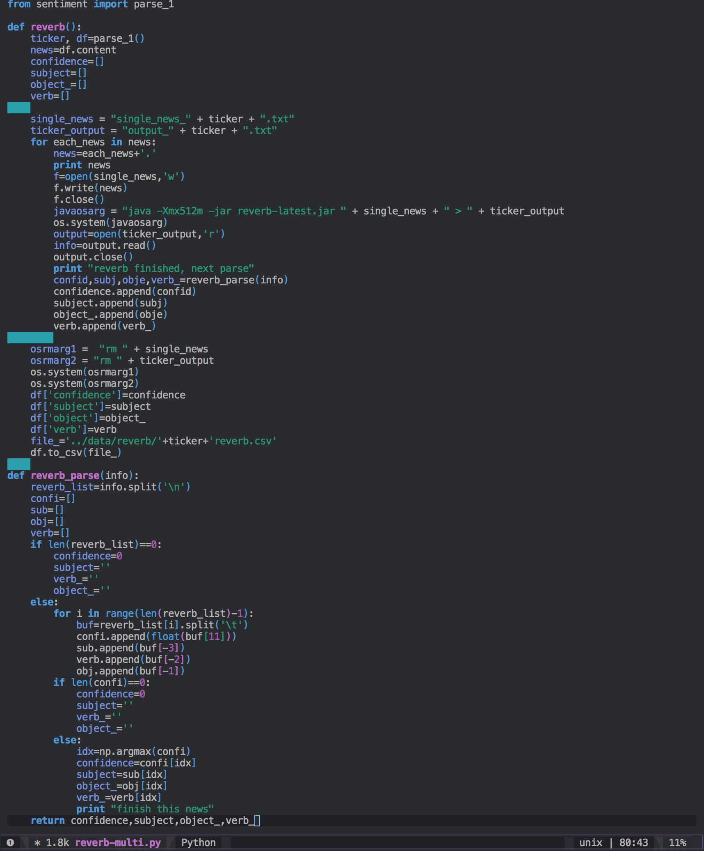
ReVerb Code
Reverb is slow
Tweaked code for concurrent data processing

Slide 12
ReVerb
Processing the data can be quite time consuming
Solution – concurrent instances to speed up data processing

Slide 13
Data Transform
News and text data have many possible transformations to assist in modeling/analysis
Sentiment Analysis with TextBlob
Word Embedding with Word2Vec
Document Embedding with Doc2Vec
Event Embedding

Slide 14
Data Storage
Stock Pricing Data
MySQL DB

Slide 15
Model Development
Foundational model
Neural Network
2 hidden layers
300 nodes, activation function: tanh(x)
50 nodes, activation function: tanh(x)
Output layer
Single node
Binary result with Sigmoid activation function

Slide 16
Dataset Development
Market Data
5 day window
S&P 500, NASDAQ Composite, NYSE Volume
Sentiment polarity
Generated with TextBlob
Word Embeddings
Uses output from ReVerb
Grabs sentence with highest confidence level
Subject, object, and verb ’tuple’ forms word embeddings
Downsides: - loss of information through selection process
Doc2vec
Converts paragraph to single vector
Use vector as input for Neural Network
Generate training dataset for each stock and combines
Downsides: - uses all info, does not filter out irrelevant text

Slide 17
Results

Slide 18
Results: AA
Actual Movement
Predicted Movement

Slide 19
Results: AA
Real Price
Aggressive Strategy
Protective Strategy

Slide 20
Results: AAPL
Actual Movement
Predicted Movement

Slide 21
Results: AAPL
Real Price
Aggressive Strategy
Protective Strategy

Slide 22
Results: BAC
Actual Movement
Predicted Movement

Slide 23
Results: BAC
Real Price
Aggressive Strategy
Protective Strategy

Slide 24
Results: CHK
Actual Movement
Predicted Movement

Slide 25
Results: CHK
Real Price
Aggressive Strategy
Protective Strategy

Slide 26
Conclusions and Insights
Accurate historical stock news is hard to acquire!
Each ‘model’ has strengths & weaknesses
Model accuracy is for relevance of text content to sentence subject
Does not imply impact of news event
Our pricing model naively assumes stocks open at previous close value
Model only predicts direction of price movement, not magnitude
This is a new approach to financial modeling is bound to grow in popularity as tools for text processing grow and historical data become more available
A next step would be to categorize events
Ie: including a corporate events overlay to better identify scheduled corporate actions

Slide 27
Q&A
Growing Popularity of Event-Driven Strategies
19% increase in net demand for Event-Driven strategies, according to 2014 Credit Suisse survey
Event-Driven strategies provide an alternative investment strategy with low correlations to economic and market trends

